Slide 1
Threads
By
Dr. Amit.

Slide 2
Introduction to Threads and Multi-threading
Threads are light weight processes.
A thread is like a mini-program inside a bigger program.
It's a way for a Java program to do multiple things at the same time, almost like having multiple small programs running within the main program.
In every Java program, we’ve at least one thread running which is the “main” thread.
In a multithreaded environment, you can create more than one thread inside an application.

Slide 3
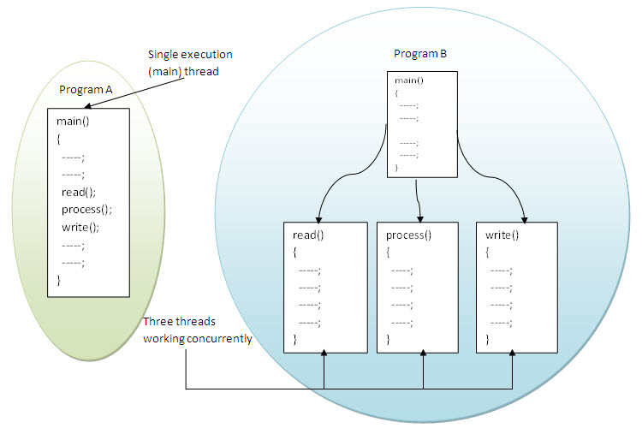
Introduction to Threads and Multi-threading

Slide 4
Thread Creation
Threads can be created in any of the two known ways:
By extending the Thread class.
By implementing the Runnable interface.

Slide 5
Thread Creation Extending Thread Class
It’s considered as the easiest method among the two.
It restricts the programmer from extending any other class (multiple inheritance not allowed).
Four steps should be followed to create thread in this way:
Create a class extending java.lang.Thread class.
Override java.lang.Thread’s run() method in your class.
Instantiate the thread by instantiating your class.
Invoke the start() method that your class inherited from the Thread class.

Slide 6
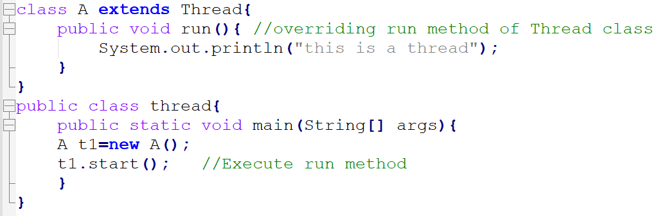
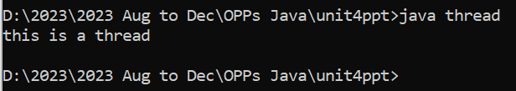
Example 1

Slide 7
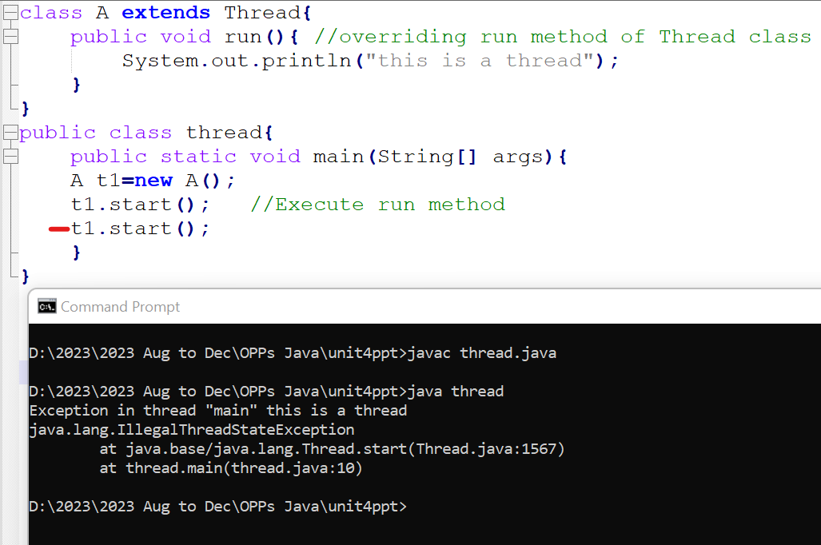
Example 2
The java.lang.IllegalThreadStateException is an exception that occurs when you attempt to start a Java thread that has already been started.
It is an unchecked exception.

Slide 8
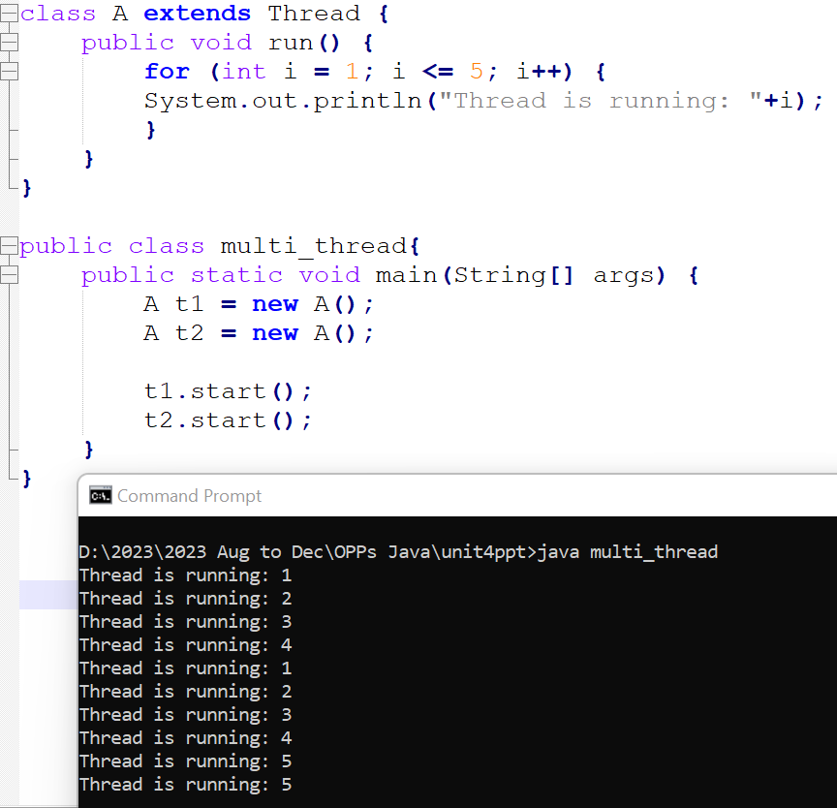
Example : Creating multiple threads
The start() method is responsible for creating a
new thread in Java.
2. When you call the start() method on a Thread object,
it tells the Java Virtual Machine (JVM) to create a
new thread and initiate the execution of the
thread's run() method.
3. The new thread runs independently, concurrently with
other threads if they exist, and executes the code
defined in the run() method.
4. The output of the program may not be in a specific order because the threads are scheduled by the JVM, and their execution order can vary.

Slide 9
Thread Creation Implementing Runnable Interface
Thread can be created by implementing java.lang.Runnable interface.
It is having single method, run(), that you need to implement when you want to create a thread's logic.
This provides the programmer liberty to extend any class.
Four steps need to be followed to create thread in this way:
Create a class implementing the Runnable interface.
Implement the run() method of Runnable interface in your class.
Create an object of the Thread class by passing an instance of the above created class.
Invoke the start() method on your Thread object.

Slide 10
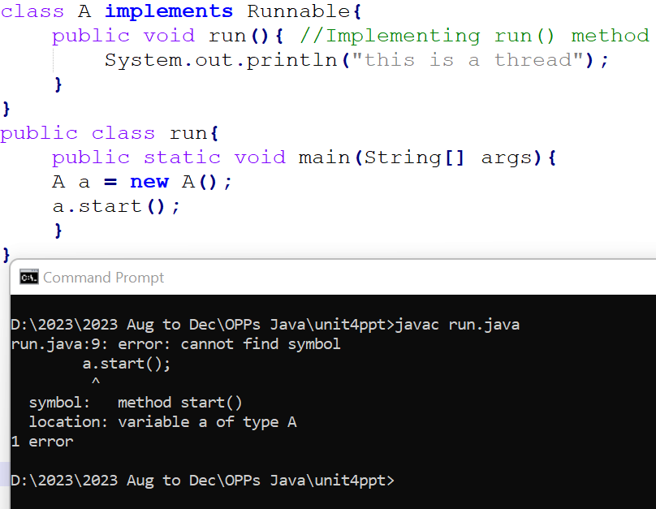
Example with ERROR
1. Error because the start() method is being
called on an instance of the A class, which
implements the Runnable interface.
2. Start() is a method of the Thread class.
3. Therefore, you need to wrap your Runnable
object in a Thread object and
then start that Thread.

Slide 11
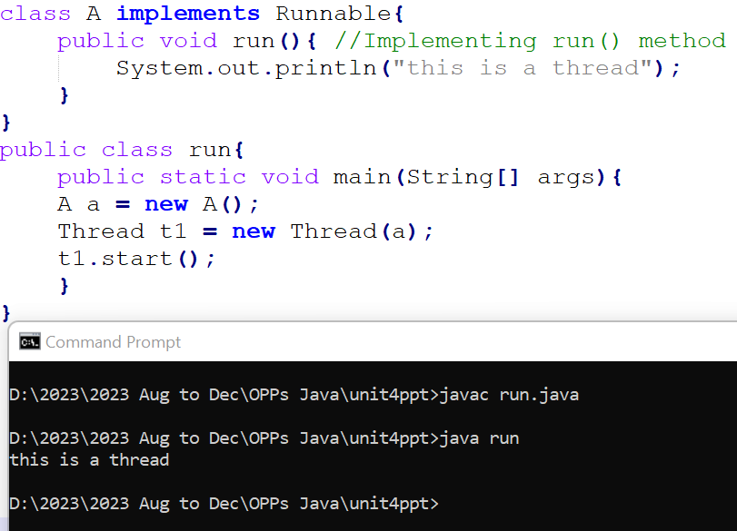
Corrected Example

Slide 12
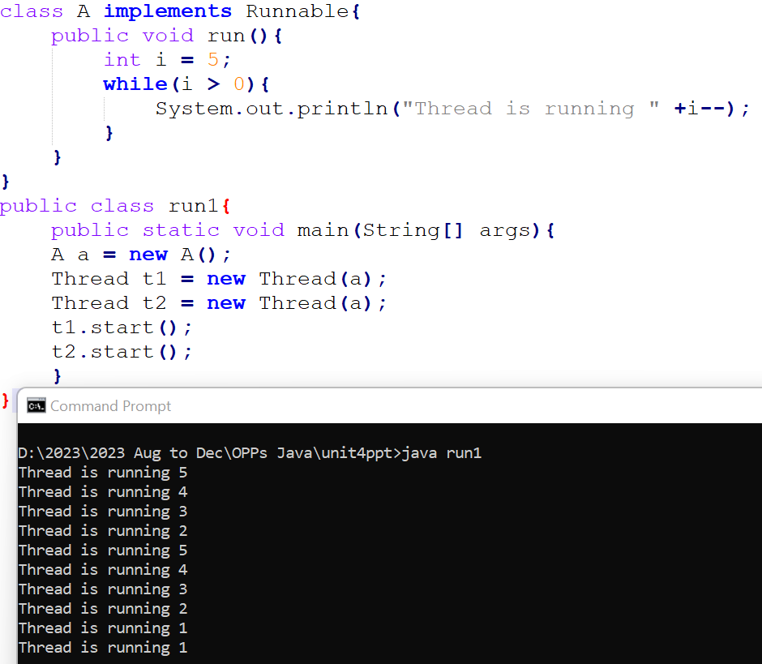
Example : Creating multiple threads by implementing Runnable interface

Slide 13
Thread Synchronization
Thread synchronization is the process of controlling the access to shared resources by multiple threads to avoid data corruption or race conditions.
Thread synchronization, using the keyword “synchronized”.
Synchronization of multiple threads in two main ways: by using synchronized methods or synchronized blocks.
Both approaches are used to prevent multiple threads from concurrently accessing or modifying shared resources and help avoid data inconsistencies and race conditions.
Synchronized Methods:
You can declare a method as synchronized by adding the synchronized keyword to the method signature. When a thread calls a synchronized method, it acquires the lock associated with the object the method belongs to, and other threads are blocked from entering that method until the lock is released.
All synchronized methods of the same object share a common lock, which means that only one synchronized method of the object can be executed at a time.

Slide 14
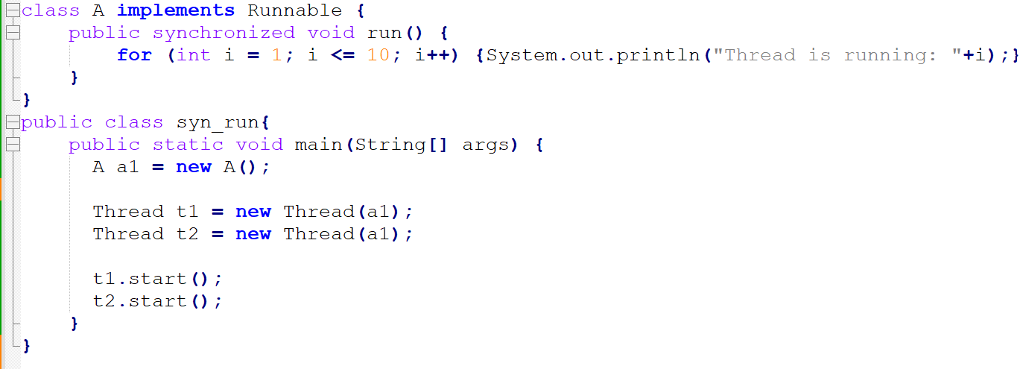
Example 1

Slide 15
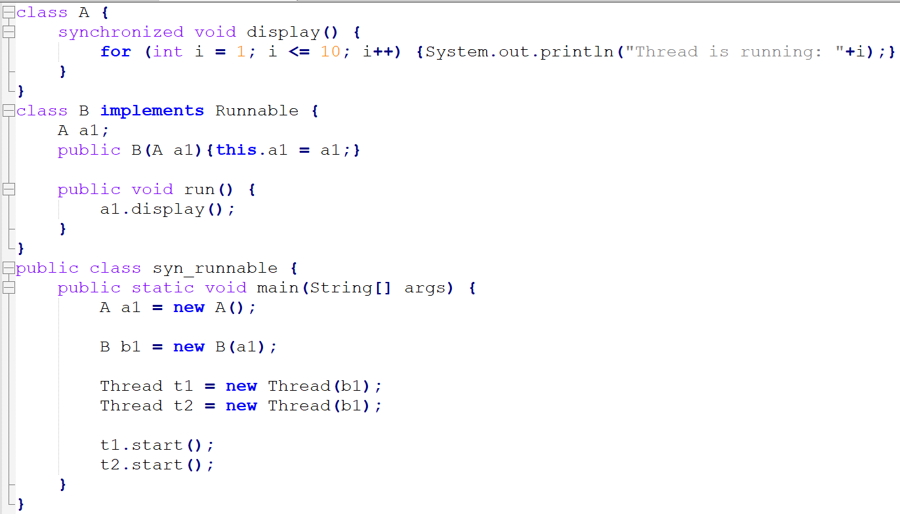
Example 2

Slide 16
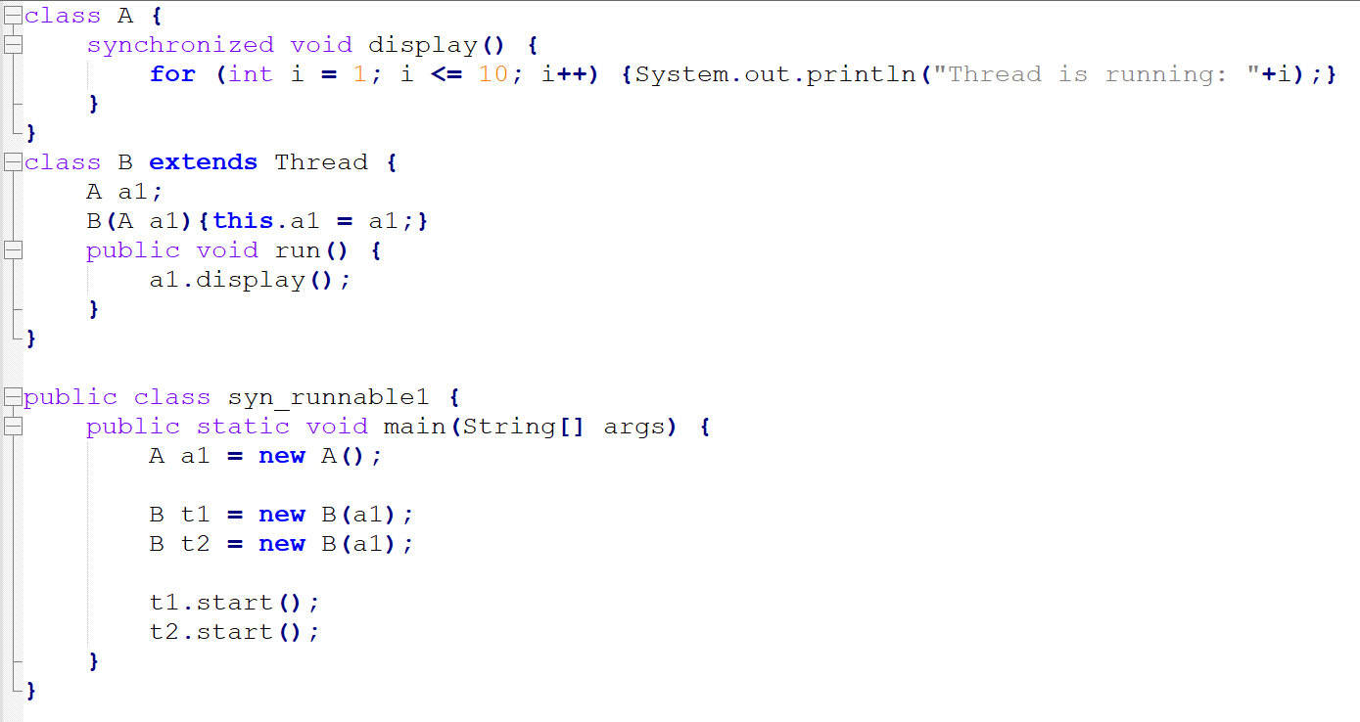
Example 3

Slide 17
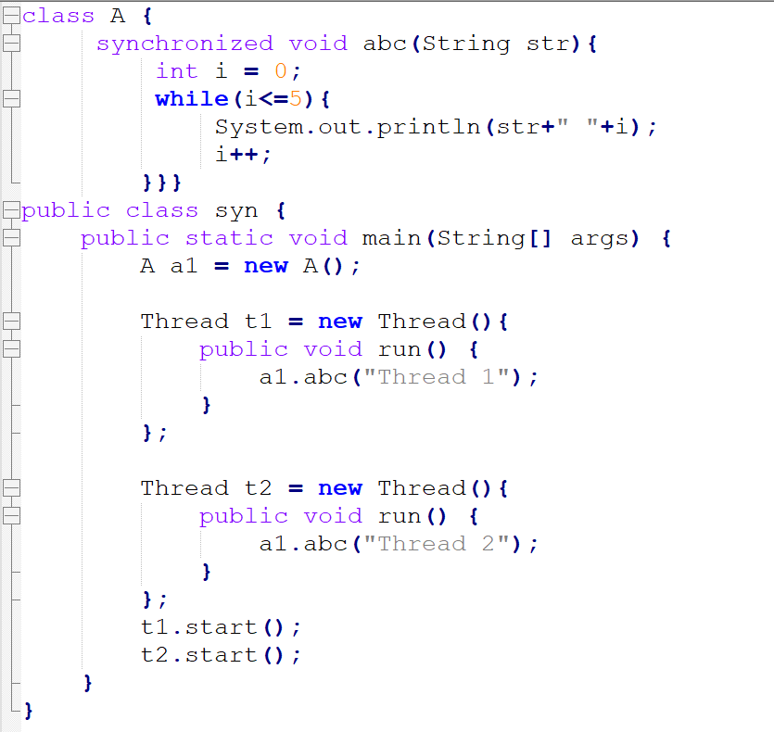
Example 4

Slide 18
Synchronized Blocks:
Synchronized blocks allow you to specify a specific block of code to be synchronized, rather than an entire method. You specify the object on which to synchronize (usually an object related to the shared resource) using the synchronized keyword.
This approach provides more fine-grained control over synchronization because you can synchronize on different objects for different parts of your code.

Slide 19
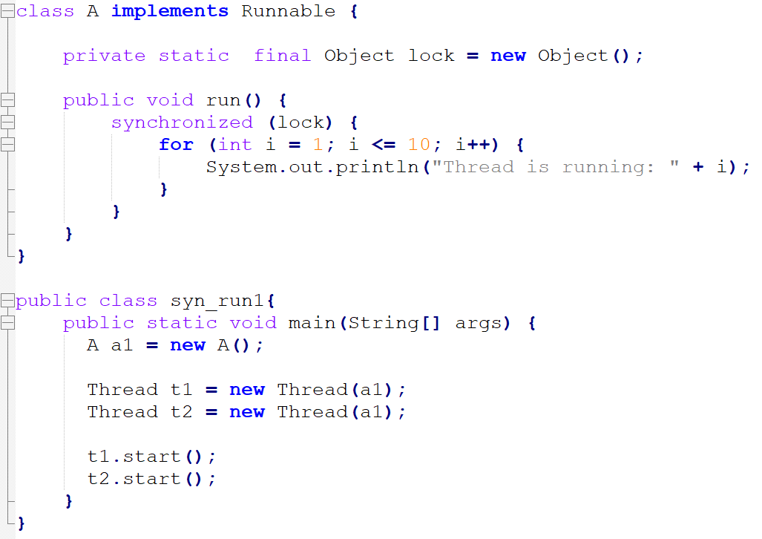
Example 1
The Object class is the root class for all
other classes.
It is at the top of the class
hierarchy and serves as the parent class
for every Java class.
All classes in
Java are implicitly or explicitly derived
from the Object class.

Slide 20
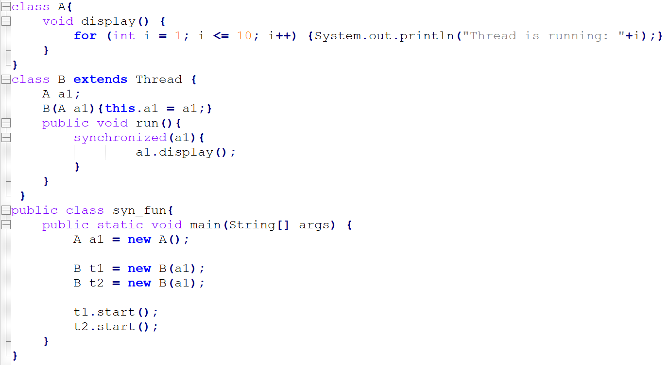
Example 2

Slide 21
Inter-thread communication
The synchronized locking mechanism suffices for keeping threads from interfering with each other, but you also need a way to communicate between threads.
For this purpose, the wait method lets one thread wait until some condition occurs, and the notification methods notifyAll and notify tell waiting threads that something has occurred that might satisfy that condition.
wait() method: Causes current thread to release the lock and wait until either another thread invokes the notify() method or the notifyAll() method for this object, or a specified amount of time has elapsed.
public final void wait(): waits until object is notified.
public final void wait(long timeout): waits for the specified amount of time.

Slide 22
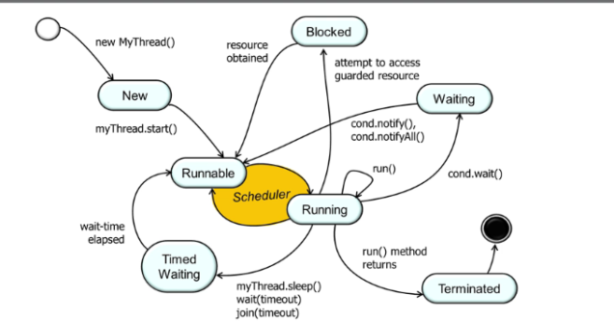
Thread States (Life Cycle of Thread)
A thread can be in one of the following states:
NEW: A thread that has not yet started is in this state.
RUNNABLE: A thread executing in the Java virtual machine is in this state.
BLOCKED: A thread that is blocked waiting for a monitor lock is in this state.
WAITING: A thread that is waiting indefinitely for another thread to perform a particular action is in this state.
TIMED_WAITING: A thread that is waiting for another thread to perform an action for up to a specified waiting time is in this state.
TERMINATED: A thread that has exited is in this state.
A thread can be in only one state at a given point in time. These states are virtual machine states which do not reflect any operating system thread states.
Source: https://bitstechnotes.wordpress.com/2017/12/16/java-thread-state-diagram/

Slide 23
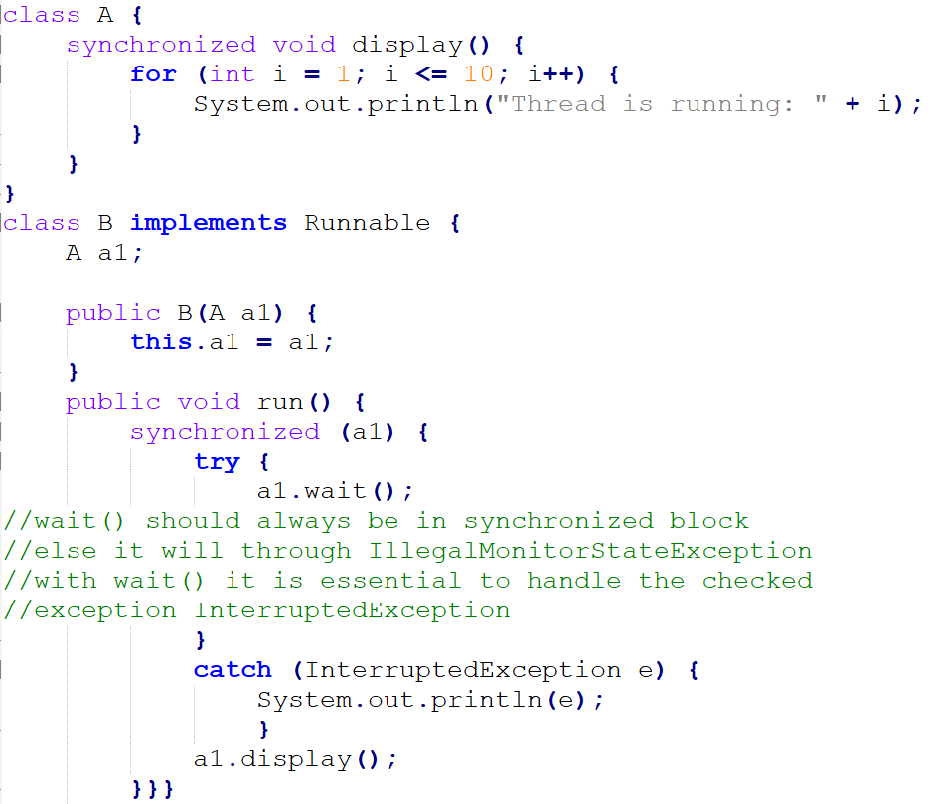
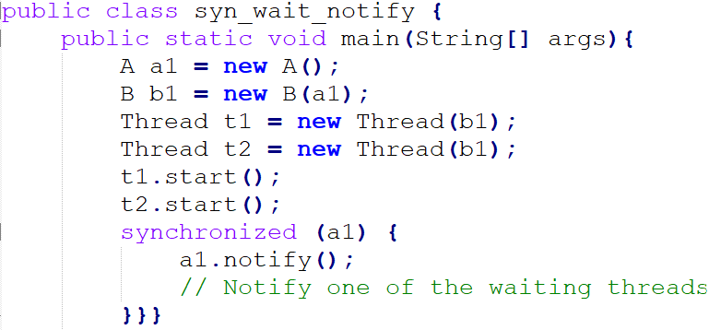

Slide 24
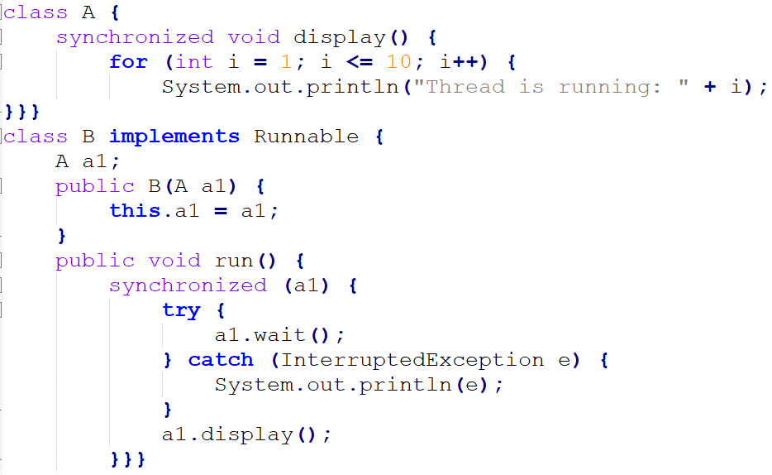
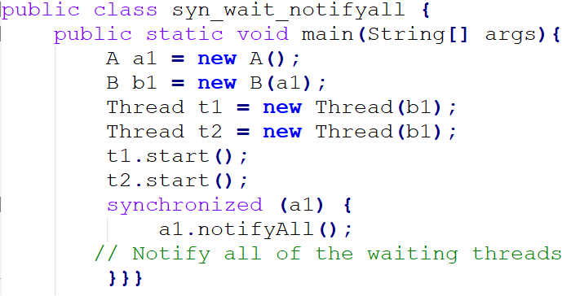

Slide 25
Thread Scheduling
The JVM schedules using a preemptive , priority-based scheduling algorithm.
All Java threads have a priority and the thread with the highest priority is scheduled to run by the JVM.
In case two threads have the same priority a FIFO ordering is followed.
A different thread is invoked to run in case one of the following events occur:
The currently running thread exits the Runnable state i.e. either blocks or terminates.
A thread with a higher priority than the thread currently running enters the Runnable state. The lower priority thread is preempted and the higher priority thread is scheduled to run.

Slide 26
Java Thread Priority
In a Multi threading environment, thread scheduler assigns processor to a thread based on priority of thread.
Whenever we create a thread in Java, it always has some priority assigned to it. Priority can either be given by JVM while creating the thread or it can be given by programmer explicitly.
Accepted value of priority for a thread is in range of 1 to 10. There are 3 static variables defined in Thread class for priority.
public static int MIN_PRIORITY: This is minimum priority that a thread can have. Value for this is 1.
public static int NORM_PRIORITY: This is default priority of a thread if do not explicitly define it. Value for this is 5.
public static int MAX_PRIORITY: This is maximum priority of a thread. Value for this is 10.

Slide 27
Java Thread Priority
Get and Set Thread Priority:
public final int getPriority(): java.lang.Thread.getPriority() method returns priority of given thread.
public final void setPriority(int newPriority): java.lang.Thread.setPriority() method changes the priority of thread to the value newPriority. This method throws IllegalArgumentException if value of parameter newPriority goes beyond minimum(1) and maximum(10) limit.

Slide 28
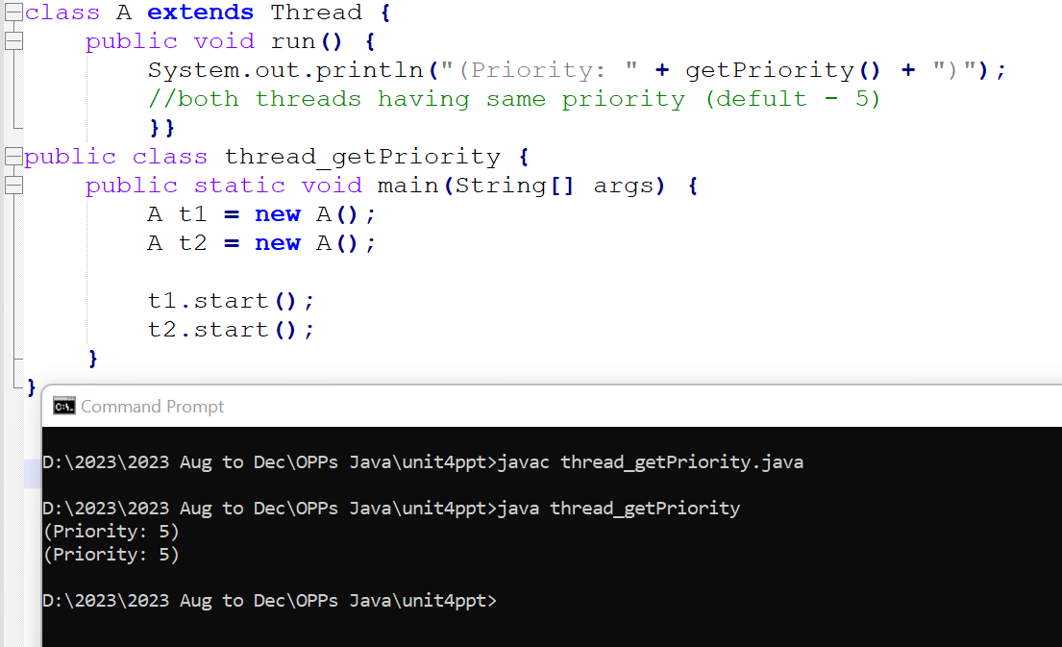
Thread getPriority()

Slide 29
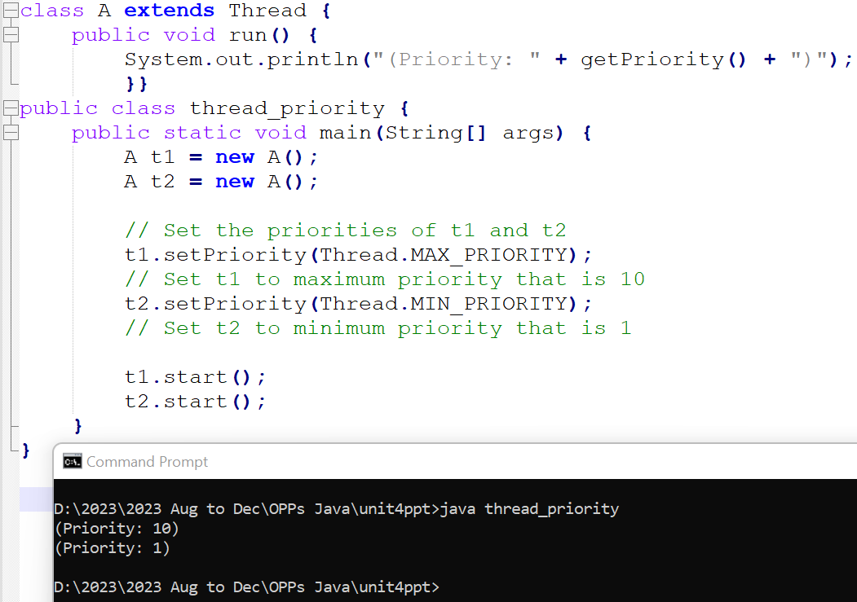
Thread setPriority()

Slide 30
In previous slide example :-
The priority of t1 to Thread.MAX_PRIORITY and the priority of t2 toThread.MIN_PRIORITY.
This should influence the order in which the threads are scheduled to run.
Thread priorities are used as hints to the thread scheduler, and in most cases, the thread with higher priority is favored in terms of CPU time allocation.
However, it's important to note that the behavior of thread priorities may vary depending on the specific JVM implementation and the underlying operating system.

Slide 31
Deadlock
Deadlock occurs when two threads have a circular dependency on a pair of synchronized objects.
For example, suppose one thread enters the monitor on object X and another thread enters the monitor on object Y. If the thread in X tries to call any synchronized method on Y, it will block as expected. However, if the thread in Y, in turn, tries to call any synchronized method on X, the thread waits forever, because to access X, it would have to release its own lock on Y so that the first thread could complete.
It may involve more than two threads and two synchronized objects. (That is, deadlock can occur through a more convoluted sequence of events than just described.)

